Slide 1
IMRank: Influence Maximization via Finding Self-Consistent Ranking
Date : 2014/12/11
Author : Suqi Cheng, Huawei Shen, Junming Huang, Wei Chen, Xueqi Cheng
Source : SIGIR’14
Advisor : Jia-ling Koh
Speaker : Shao-Chun Peng

Slide 2
Outline
Introduction
Motivation
purpose
Related Work
Approach
Experimental
Conclusion

Slide 3
Motivation
Influence maximization, fundamental for word-of-mouth marketing and viral marketing
expert finding
online advertising and marketing

Slide 4
diffusion model
Set of mathematical equations or formulas that attempts to estimate the spread of information (idea or rumor) or a contagious disease through a population.

Slide 5
purpose
find a set of seed nodes maximizing influence spread on social network

Slide 6
Outline
Introduction
Related Work
Approach
Experimental
Conclusion

Slide 7
Related Work
Greedy algorithms
Maximal Marginal influence spread
High computational cost
Heuristic algorithms
Estimating influence spread
unstable accuracy
Marginal influence spread: Given a node set S ⊆ V and a node v ∈ V , the marginal influence spread of v upon S is defined as M(v|S) = I(S∪{v})−I(S).

Slide 8
Outline
Introduction
Related Work
Approach
Experimental
Conclusion

Slide 9
Self-consistent
solve the influence maximization problem through finding a desired self-consistent ranking
Self-consistent ranking: A ranking r is a self-consistent ranking iff Mr(vri ) ≥ Mr(vrj ), ∀1 ≤ i < j ≤ n.

Slide 10
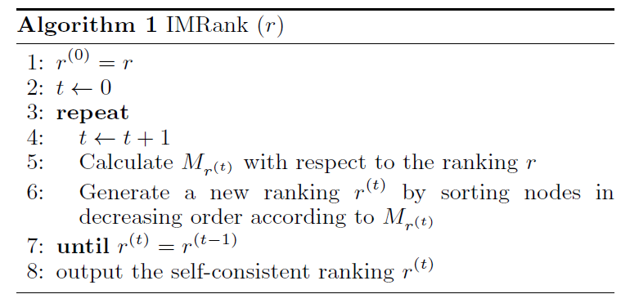
Framework
Give a initial ranking and a social network
IMRank
self-consistent ranking
Greedy strategy
set of seed nodes maximizing influence spread

Slide 11
Initial ranking
How to get a initial ranking
Random
Degree
InversedDegree
Strength
PageRank

Slide 12
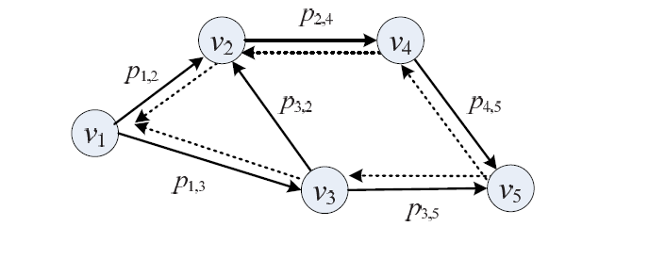
IMRank
η(vrj , vri ) =

Slide 13
Calculate Mr(r)
1. Each node can only be activated by nodes ranked higher than it in the given ranking;
2. When a node could be activated by multiple nodes, higher-ranked node has higher priority to activate it.

Slide 14
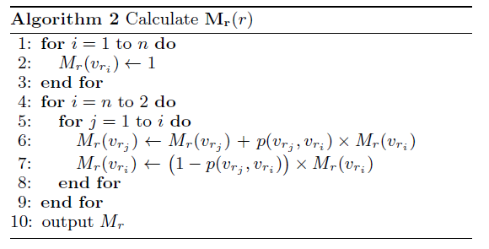
Calculate Mr(r)
 | Value |  | i =5 | i=4 | i=3 | i=2
Mr(vr1 )= | (1+p(1,3)*(1+p(3,5)))+p(1,2)*(1+p(2,4)*(1+p(4,5)*(1-p(3,5)))) | j=1 | done | done | done | done
Mr(vr2 )= | (1-p(1,2))*(1+p(2,4)*(1+p(4,5)*(1-p(3,5)))) | j=2 | done | done | done | done
Mr(vr3 )= | (1-p*(1,3)(1+p(3,5)) | j=3 | done | done | done | X
Mr(vr4 )= | (1-p(2,4))(1+p(4,5)*(1-p(3,5))) | j=4 | done | done | X | X
Mr(vr5 )= | (1-p(4,5))*(1-p(3,5)) | j=5 | done | X | X | X
 | Value |  | i =5 | i=4 | i=3 | i=2
Mr(vr1 )= | (1+p(1,3)*(1+p(3,5)))+p(1,2)*(1+p(2,4)*(1+p(4,5)*(1-p(3,5)))) | j=1 | done | done | done
Mr(vr2 )= | (1-p(1,2))*(1+p(2,4)*(1+p(4,5)*(1-p(3,5)))) | j=2 | done | done | done
Mr(vr3 )= | (1-p*(1,3)(1+p(3,5)) | j=3 | done | done | done | X
Mr(vr4 )= | (1-p(2,4))(1+p(4,5)*(1-p(3,5))) | j=4 | done | done | X | X
Mr(vr5 )= | (1-p(4,5))*(1-p(3,5)) | j=5 | done | X | X | X
 | Value |  | i =5 | i=4 | i=3 | i=2
Mr(vr1 )= | (1+p(1,3)*(1+p(3,5)))+p(1,2)*(1+p(2,4)*(1+p(4,5)*(1-p(3,5)))) | j=1 | done | done | done | done
Mr(vr2 )= | (1-p(1,2))*(1+p(2,4)*(1+p(4,5)*(1-p(3,5)))) | j=2 | done | done | done
Mr(vr3 )= | (1-p*(1,3)(1+p(3,5)) | j=3 | done | done | done | X
Mr(vr4 )= | (1-p(2,4))(1+p(4,5)*(1-p(3,5))) | j=4 | done | done | X | X
Mr(vr5 )= | (1-p(4,5))*(1-p(3,5)) | j=5 | done | X | X | X
 | Value |  | i =5 | i=4 | i=3 | i=2
Mr(vr1 )= | (1+p(1,3)*(1+p(3,5)))+p(1,2)*(1+p(2,4)*(1+p(4,5)*(1-p(3,5)))) | j=1 | done | done | done
Mr(vr2 )= | 1+p(2,4)*(1+p(4,5)*(1-p(3,5))) | j=2 | done | done | done
Mr(vr3 )= | (1-p*(1,3)(1+p(3,5)) | j=3 | done | done | done | X
Mr(vr4 )= | (1-p(2,4))(1+p(4,5)*(1-p(3,5))) | j=4 | done | done | X | X
Mr(vr5 )= | (1-p(4,5))*(1-p(3,5)) | j=5 | done | X | X | X
 | Value |  | i =5 | i=4 | i=3 | i=2
Mr(vr1 )= | 1+p(1,3)*(1+p(3,5)) | j=1 | done | done
Mr(vr2 )= | 1+p(2,4)*(1+p(4,5)*(1-p(3,5))) | j=2 | done | done
Mr(vr3 )= | (1-p*(1,3)(1+p(3,5)) | j=3 | done | done |  | X
Mr(vr4 )= | (1-p(2,4))(1+p(4,5)*(1-p(3,5))) | j=4 | done | done | X | X
Mr(vr5 )= | (1-p(4,5))*(1-p(3,5)) | j=5 | done | X | X | X
 | Value |  | i =5 | i=4 | i=3 | i=2
Mr(vr1 )= | 1+p(1,3)*(1+p(3,5)) | j=1 | done | done | done
Mr(vr2 )= | 1+p(2,4)*(1+p(4,5)*(1-p(3,5))) | j=2 | done | done
Mr(vr3 )= | (1-p*(1,3)(1+p(3,5)) | j=3 | done | done |  | X
Mr(vr4 )= | (1-p(2,4))(1+p(4,5)*(1-p(3,5))) | j=4 | done | done | X | X
Mr(vr5 )= | (1-p(4,5))*(1-p(3,5)) | j=5 | done | X | X | X
 | Value |  | i =5 | i=4 | i=3 | i=2
Mr(vr1 )= | 1+p(1,3)*(1+p(3,5)) | j=1 | done | done | done
Mr(vr2 )= | 1+p(2,4)*(1+p(4,5)*(1-p(3,5))) | j=2 | done | done | done
Mr(vr3 )= | (1-p*(1,3)(1+p(3,5)) | j=3 | done | done |  | X
Mr(vr4 )= | (1-p(2,4))(1+p(4,5)*(1-p(3,5))) | j=4 | done | done | X | X
Mr(vr5 )= | (1-p(4,5))*(1-p(3,5)) | j=5 | done | X | X | X
 | Value |  | i =5 | i=4 | i=3 | i=2
Mr(vr1 )= | 1+p(1,3)*(1+p(3,5)) | j=1 | done | done | done
Mr(vr2 )= | 1+p(2,4)*(1+p(4,5)*(1-p(3,5))) | j=2 | done | done | done
Mr(vr3 )= | (1-p*(1,3)(1+p(3,5)) | j=3 | done | done | done | X
Mr(vr4 )= | (1-p(2,4))(1+p(4,5)*(1-p(3,5))) | j=4 | done | done | X | X
Mr(vr5 )= | (1-p(4,5))*(1-p(3,5)) | j=5 | done | X | X | X
 | Value |  | i =5 | i=4 | i=3 | i=2
Mr(vr1 )= | 1 | j=1 | done | done
Mr(vr2 )= | 1+p(2,4)*(1+p(4,5)*(1-p(3,5))) | j=2 | done
Mr(vr3 )= | 1+p(3,5) | j=3 | done |  |  | X
Mr(vr4 )= | (1-p(2,4))(1+p(4,5)*(1-p(3,5))) | j=4 | done |  | X | X
Mr(vr5 )= | (1-p(4,5))*(1-p(3,5)) | j=5 | done | X | X | X
 | Value |  | i =5 | i=4 | i=3 | i=2
Mr(vr1 )= | 1 | j=1 | done | done
Mr(vr2 )= | 1+p(2,4)*(1+p(4,5)*(1-p(3,5))) | j=2 | done | done
Mr(vr3 )= | 1+p(3,5) | j=3 | done | done |  | X
Mr(vr4 )= | (1-p(2,4))(1+p(4,5)*(1-p(3,5))) | j=4 | done |  | X | X
Mr(vr5 )= | (1-p(4,5))*(1-p(3,5)) | j=5 | done | X | X | X
 | Value |  | i =5 | i=4 | i=3 | i=2
Mr(vr1 )= | 1 | j=1 | done | done
Mr(vr2 )= | 1+p(2,4)*(1+p(4,5)*(1-p(3,5))) | j=2 | done | done
Mr(vr3 )= | 1+p(3,5) | j=3 | done | done |  | X
Mr(vr4 )= | (1-p(2,4))(1+p(4,5)*(1-p(3,5))) | j=4 | done | done | X | X
Mr(vr5 )= | (1-p(4,5))*(1-p(3,5)) | j=5 | done | X | X | X
 | Value |  | i =5 | i=4 | i=3 | i=2
Mr(vr1 )= | 1 | j=1 | done | done
Mr(vr2 )= | 1+p(2,4)*(1+p(4,5)*(1-p(3,5))) | j=2 | done
Mr(vr3 )= | 1+p(3,5) | j=3 | done |  |  | X
Mr(vr4 )= | 1+p(4,5)*(1-p(3,5)) | j=4 | done |  | X | X
Mr(vr5 )= | (1-p(4,5))*(1-p(3,5)) | j=5 | done | X | X | X
 | value |  | i =5 | i=4 | i=3 | i=2
Mr(vr1 )= | 1 | j=1 | done
Mr(vr2 )= | 1 | j=2 | done
Mr(vr3 )= | 1+p(3,5) | j=3 | done |  |  | X
Mr(vr4 )= | 1+p(4,5)*(1-p(3,5)) | j=4 |  |  | X | X
Mr(vr5 )= | (1-p(4,5))*(1-p(3,5)) | j=5 |  | X | X | X
 | value |  | i =5 | i=4 | i=3 | i=2
Mr(vr1 )= | 1 | j=1 | done
Mr(vr2 )= | 1 | j=2 | done
Mr(vr3 )= | 1+p(3,5) | j=3 | done |  |  | X
Mr(vr4 )= | 1+p(4,5)*(1-p(3,5)) | j=4 | done |  | X | X
Mr(vr5 )= | (1-p(4,5))*(1-p(3,5)) | j=5 | done | X | X | X
 | value |  | i =5 | i=4 | i=3 | i=2
Mr(vr1 )= | 1 | j=1 | done
Mr(vr2 )= | 1 | j=2 | done
Mr(vr3 )= | 1+p(3,5) | j=3 | done |  |  | X
Mr(vr4 )= | 1+p(4,5)*(1-p(3,5)) | j=4 | done |  | X | X
Mr(vr5 )= | (1-p(4,5))*(1-p(3,5)) | j=5 |  | X | X | X
 | value |  | i =5 | i=4 | i=3 | i=2
Mr(vr1 )= | 1 | j=1 | done
Mr(vr2 )= | 1 | j=2 | done
Mr(vr3 )= | 1+p(3,5) | j=3 | done |  |  | X
Mr(vr4 )= | 1+p(4,5)*(1-p(3,5)) | j=4 | done |  | X | X
Mr(vr5 )= | (1-p(4,5))*(1-p(3,5)) | j=5 | done | X | X | X
 | value |  | i =5 | i=4 | i=3 | i=2
Mr(vr1 )= | 1 | j=1 | done | done
Mr(vr2 )= | 1 | j=2 | done
Mr(vr3 )= | 1+p(3,5) | j=3 | done |  |  | X
Mr(vr4 )= | 1+p(4,5)*(1-p(3,5)) | j=4 | done |  | X | X
Mr(vr5 )= | (1-p(4,5))*(1-p(3,5)) | j=5 | done | X | X | X
 | value |  | i =5 | i=4 | i=3 | i=2
Mr(vr1 )= | 1 | j=1 | done
Mr(vr2 )= | 1 | j=2 | done
Mr(vr3 )= | 1+p(3,5) | j=3 | done |  |  | X
Mr(vr4 )= | 1+p(4,5)*(1-p(3,5)) | j=4 |  |  | X | X
Mr(vr5 )= | 1-p(3,5) | j=5 |  | X | X | X
 | value |  | i =5 | i=4 | i=3 | i=2
Mr(vr1 )= | 1 | j=1 | done
Mr(vr2 )= | 1 | j=2 | done
Mr(vr3 )= | 1 | j=3 |  |  |  | X
Mr(vr4 )= | 1 | j=4 |  |  | X | X
Mr(vr5 )= | 1 | j=5 |  | X | X | X
 | value |  | i =5 | i=4 | i=3 | i=2
Mr(vr1 )= | 1 | j=1 | done
Mr(vr2 )= | 1 | j=2 | done
Mr(vr3 )= | 1+p(3,5)*1 | j=3 |  |  |  | X
Mr(vr4 )= | 1 | j=4 |  |  | X | X
Mr(vr5 )= | 1 | j=5 |  | X | X | X
 | value |  | i =5 | i=4 | i=3 | i=2
Mr(vr1 )= | 1 | j=1 | done
Mr(vr2 )= | 1 | j=2 | done
Mr(vr3 )= | 1+p(3,5)*1 | j=3 |  |  |  | X
Mr(vr4 )= | 1 | j=4 |  |  | X | X
Mr(vr5 )= | 1-p(3,5)*1 | j=5 |  | X | X | X
 | value |  | i =5 | i=4 | i=3 | i=2
Mr(vr1 )= | 1 | j=1 | done
Mr(vr2 )= | 1 | j=2 | done
Mr(vr3 )= | 1+p(3,5)*1 | j=3 | done |  |  | X
Mr(vr4 )= | 1 | j=4 |  |  | X | X
Mr(vr5 )= | 1-p(3,5)*1 | j=5 |  | X | X | X
 | value |  | i =5 | i=4 | i=3 | i=2
Mr(vr1 )= | 1 | j=1
Mr(vr2 )= | 1 | j=2
Mr(vr3 )= | 1 | j=3 |  |  |  | X
Mr(vr4 )= | 1 | j=4 |  |  | X | X
Mr(vr5 )= | 1 | j=5 |  | X | X | X
 | value |  | i =5 | i=4 | i=3 | i=2
Mr(vr1 )= | 1 | j=1 | done
Mr(vr2 )= | 1 | j=2
Mr(vr3 )= | 1 | j=3 |  |  |  | X
Mr(vr4 )= | 1 | j=4 |  |  | X | X
Mr(vr5 )= | 1 | j=5 |  | X | X | X

Slide 15
Calculate Mr(r)
1. Each node can only be activated by nodes ranked higher than it in the given ranking;
2. When a node could be activated by multiple nodes, higher-ranked node has higher priority to activate it.

Slide 16
Outline
Introduction
Related Work
Approach
Experimental
Conclusion

Slide 17
Dataset
scientific collaboration network :High Energy Physics-Theory(HEPT)
15K nodes and 59K edges

Slide 18
network
Weighted independent cascade (WIC)
Each edge (u, v) is assigned a propagation probability p(u, v) = 1/dv, where dv is the indegree of node v.
Trivalency independent cascade(TIC) [3]
Each edge is assigned a propagation probability selected from {0.1,0.01,0.001} in a uniform random manner

Slide 19
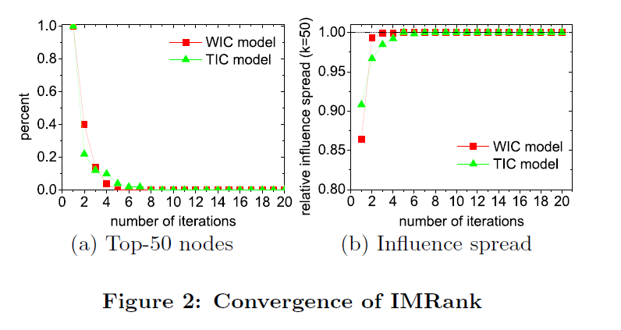
Convergence of IMRank

Slide 20
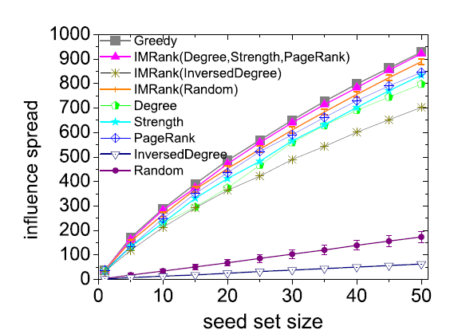
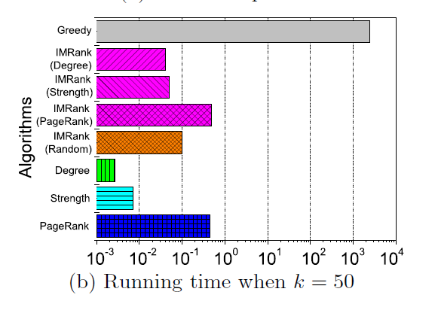
Initial ranking

Slide 21
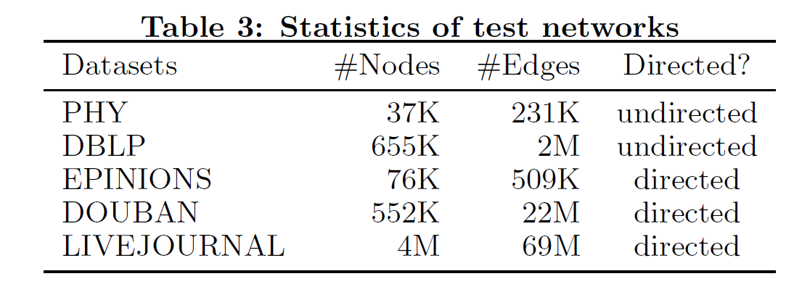
Dataset

Slide 22
Algorithms
IMRank1
Degree as initial ranking and l = 1, 10 round
IMRank2
Degree as initial ranking and l = 2, 10 round
PMIA
heuristic algorithm [3].
IRIE
heuristic algorithm [10].

Slide 23
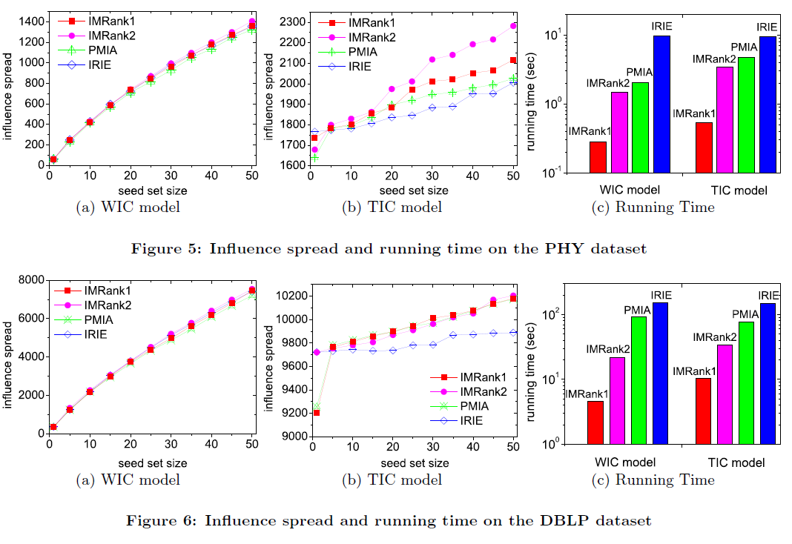
Result

Slide 24
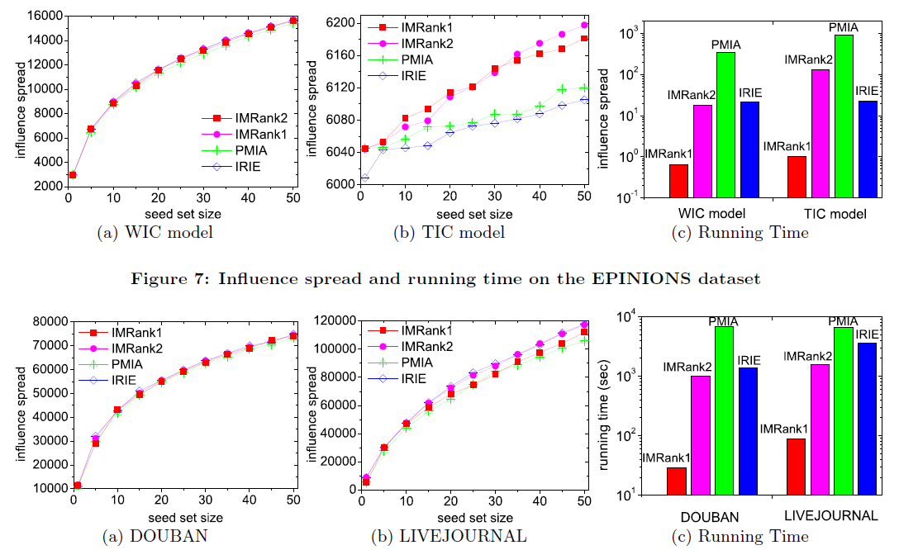
Result

Slide 25
Outline
Introduction
Related Work
Approach
Experimental
Conclusion

Slide 26
Conclusions
prove the convergence of IMRank and analyze the impact of initial ranking
Efficient iterative framework IMRank to explore the benefits of accurate greedy algorithms and efficient heuristic estimation of influence spread

